Slide 1
CT4029 Principles of Programming Day 5 – Session 10 – Part 1 Create and Read QR code Checking Password Strength

Slide 2
Learning Outcomes
Create a QR code
Read a QR code
Check the password strength

Slide 3
Create a QR code

Slide 4
What is a QR code?
QR codes are machine readable two dimensional pixelated barcodes which can be used to store a variety of information. QR in QR code stands for Quick Response.
QR code was invented by a Japanese engineer Masahiro Hara from automobile manufacturer Denso Wave in the year 1994 to track the movement of car parts.

Slide 5
What is a QR code?
QR Code has increased in popularity in the later 2010s with improvement in optical capabilities of mobile phones and their wide adoption.
Nowadays, QR codes are being used for wide variety of applications like, make online payments, check hotel menu, share Wifi password, obtain price and other details of products etc. QR Codes have become so popular that now every new smartphone comes with in built QR code reader.

Slide 6
Install Required Packages
pip install opencv-python
pip install qrcode
pip install numpy
pip install Image

Slide 7
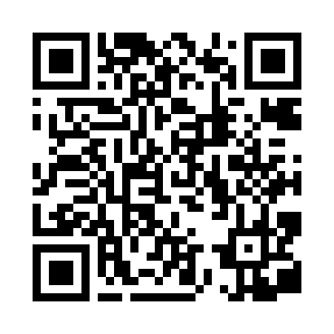
Generate QR Code
import qrcode # Data for which you want to make QR code # Here we are using the URL of the MakeUseOf website data = "https://moodle.glos.ac.uk/course/view.php?id=49331/" # File name of the QR code Image # Change it with your desired file name QRCodefile = "CT4029.png" # Generating the QR code QRimage = qrcode.make(data) # Saving image into a file QRimage.save(QRCodefile)

Slide 8
Generate a Customised QR Code: Changing Image and Box Size
You can change the QR code image size using the version parameter in the QRCode class. It accepts an integer between 1 and 40 where 1 is equivalent to 21x21 matrix and 40 is equivalent to 185x185 matrix. Note that the data doesn’t fit in the specified size, the version will scale up automatically.
Similarly, you can change the box size using the box_size parameter in the QRCode class. It specifies the pixels of each box in the QR code.

Slide 9

Generate a Customised QR Code: Changing Image and Box Size
# Importing libraries import qrcode import numpy as np # Data which for you want to make QR code # Here we are using URL of MakeUseOf website data = "https://moodle.glos.ac.uk/course/view.php?id=49331/" # Name of the QR code Image file QRCodefile = "CT4029.png" # instantiate QRCode object qrObject = qrcode.QRCode(version=1, box_size=12q) # add data to the QR code qrObject.add_data(data) # compile the data into a QR code array qrObject.make() image = qrObject.make_image() image.save(QRCodefile) # print the image size (version) print("Size of the QR image(Version):") print(np.array(qrObject.get_matrix()).shape)
Size of the QR image(Version):
(41, 41)

Slide 10
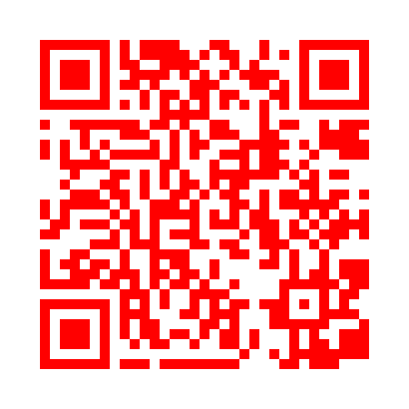
Generate a Customised QR Code : Changing Fill Color
You can change the fill color of the QR code by using the fill_color parameter.
# Importing library import qrcode # Data for which you want to make QR Code # Here we are using URL of MakeUseOf website data = "https://moodle.glos.ac.uk/course/view.php?id=49331/" # Name of the QR Code Image file QRCodefile = "CT4029.png" # instantiate QRCode object qrObject = qrcode.QRCode() # add data to the QR code qrObject.add_data(data) # compile the data into a QR code array qrObject.make() image = qrObject.make_image(fill_color="red") # Saving image into a file image.save(QRCodefile)

Slide 11
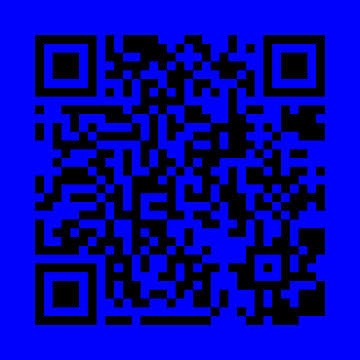
Generate a Customised QR Code : Changing Background Color
You can change the background color of the QR code by using the back_color parameter.
# Importing library import qrcode # Data for which you want to make QR Code # Here we are using URL of MakeUseOf website data = "https://moodle.glos.ac.uk/course/view.php?id=49331/" # Name of the QR Code Image file QRCodefile = "CT4029.png" # instantiate QRCode object qrObject = qrcode.QRCode() # add data to the QR code qrObject.add_data(data) # compile the data into a QR code array qrObject.make() image = qrObject.make_image(back_color="blue") # Saving image into a file image.save(QRCodefile)

Slide 12
Generate a Customised QR Code : Changing Border Thickness
You can change the border thickness of the QR code by using the border parameter in the QRCode method.
# Importing libraries import qrcode # Data for which you want to make QR Code # Here we are using URL of MakeUseOf website data = "https://moodle.glos.ac.uk/course/view.php?id=49331/" # Name of the QR Code Image file QRCodefile = "CT4029.png" # instantiate QRCode object qrObject = qrcode.QRCode(border=10) # add data to the QR code qrObject.add_data(data) # compile the data into a QR code array qrObject.make() image = qrObject.make_image() image.save(QRCodefile)

Slide 13
Read a QR code

Slide 14
Generate a Customised QR Code : Decode QR Code Using QR Code Image
You can decode information from the QR code image using Python's OpenCV library. OpenCV has an inbuilt QR code detector. Using the detector you can decode data out of the QR code.

Slide 15
# Import Library import cv2 # Name of the QR Code Image file filename = "CT4029.png" # read the QRCODE image image = cv2.imread(filename) # initialize the cv2 QRCode detector detector = cv2.QRCodeDetector() # detect and decode data, vertices_array, binary_qrcode = detector.detectAndDecode(image) # if there is a QR code # print the data if vertices_array is not None: print("QRCode data:") print(data) else: print("There was some error")
Output:
QRCode data: https://moodle.glos.ac.uk/course/view.php?id=49331/

Slide 16
Check the Password strength

Slide 17
Scenario
In this program, we will be taking a password as a combination of alphanumeric characters along with special characters, and check whether the password is valid or not with the help of few conditions.
Primary conditions for password validation :
Minimum 8 characters.
The alphabets must be between [a-z]
At least one alphabet should be of Upper Case [A-Z]
At least 1 number or digit between [0-9].
At least 1 character from [ _ or @ or $ ].

Slide 18
Examples of Inputs and Expected Output
Input : R@m@_f0rtu9e$
Output : Valid Password
Input : Rama_fortune$
Output : Invalid Password
Explanation: Number is missing
Input : Rama#fortu9e
Output : Invalid Password
Explanation: Must consist from _ or @ or $

Slide 19
Regular expression
A Regular Expressions (RegEx) is a special sequence of characters that uses a search pattern to find a string or set of strings. It can detect the presence or absence of a text by matching with a particular pattern, and also can split a pattern into one or more sub-patterns.
Python provides a re module that supports the use of regex in Python. Its primary function is to offer a search, where it takes a regular expression and a string. Here, it either returns the first match or else none.
Installing re module: pip install regex

Slide 20
Python program to check the validity of a Password
import re
password = "R@m@_f0rtu9e$"
flag = 0
while True:
if (len(password)<8):
flag = -1
break
elif not re.search("[a-z]", password):
flag = -1
break
elif not re.search("[A-Z]", password):
flag = -1
break
elif not re.search("[0-9]", password):
flag = -1
break
elif not re.search("[_@$]", password):
flag = -1
break
elif re.search("\s", password):
flag = -1
break
else:
flag = 0
print("Valid Password")
break
if flag ==-1:
print("Not a Valid Password")

Slide 21
Next Part!
Assignment Workshop ☺

